Slide 1



REAL TIME CHAT APPLICATION
Guidance By -
Miss. Kiran Tiwari.
Presented By -
Fazal Sayyed, Karan Sharma,
Ashish Palnitkar & Amol Tule.

Slide 2

Overview
Introduction
Objective
Purpose & Solution
ER – Diagram
Technology
Back-End Development
Front-End Development
Future & Scope
Conclusion

Slide 3


INTRODUCTION
Our project is related to a way of chatting with people. Chatting and communicating with people through internet is becoming common to people & isconnecting people all over the world.
Chatting apps in today's world mainly focus on connecting people.

Slide 4



OBJECTIVES
Real-time messaging - Users will be able to send and receive messages in real-time without refreshing the page.
Support multiple users and group chats.
Ensure message security and privacy.

Slide 5



PURPOSE
Real-time chat applications are designed to provide a responsive and interactive experience. They allow users to send and receive messages in real time, like Instant Communication, Community Building, Information Sharing.

Slide 6
SOLUTION
Text messaging is the core feature, allowing users to send and receive messages instantly.
Group Chats:-
Solution: Group chat functionality allows multiple users to participate in a conversation simultaneously, facilitating teamwork and community building.
Security and Privacy:-
Solution: Implement robust security measures to protect user data and ensure privacy. This includes end-to-end encryption and secure authentication.

Slide 7
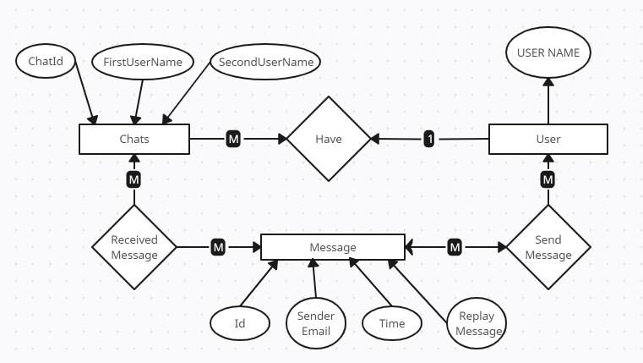
ER – DIAGRAM

Slide 8
TECHNOLOGY
Backend
Frontend
SpringBoot
MySQL
JPA
HTML
CSS
JS
Angular
BootStrap

Slide 9
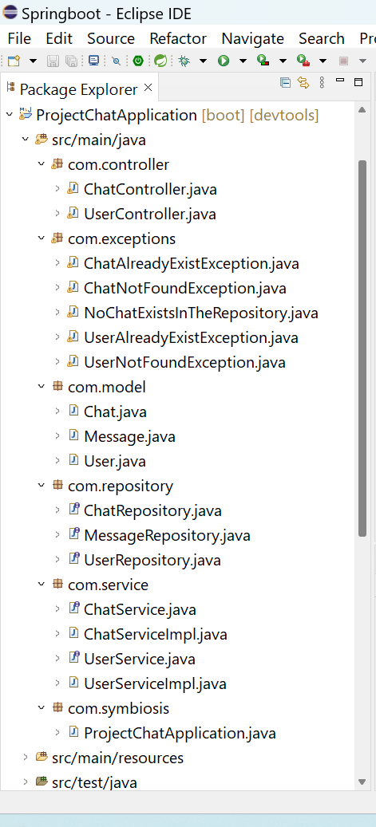
BACK-END DEVELOPMENT
Communication between Front-End and Back-End
1) Encapsulation ( Single unit processing)
Exception Handling
2 ) Abstraction
( hiding implementation and showing the functionality)
Entities
To Perform Actions
It Provides functionality

Slide 10
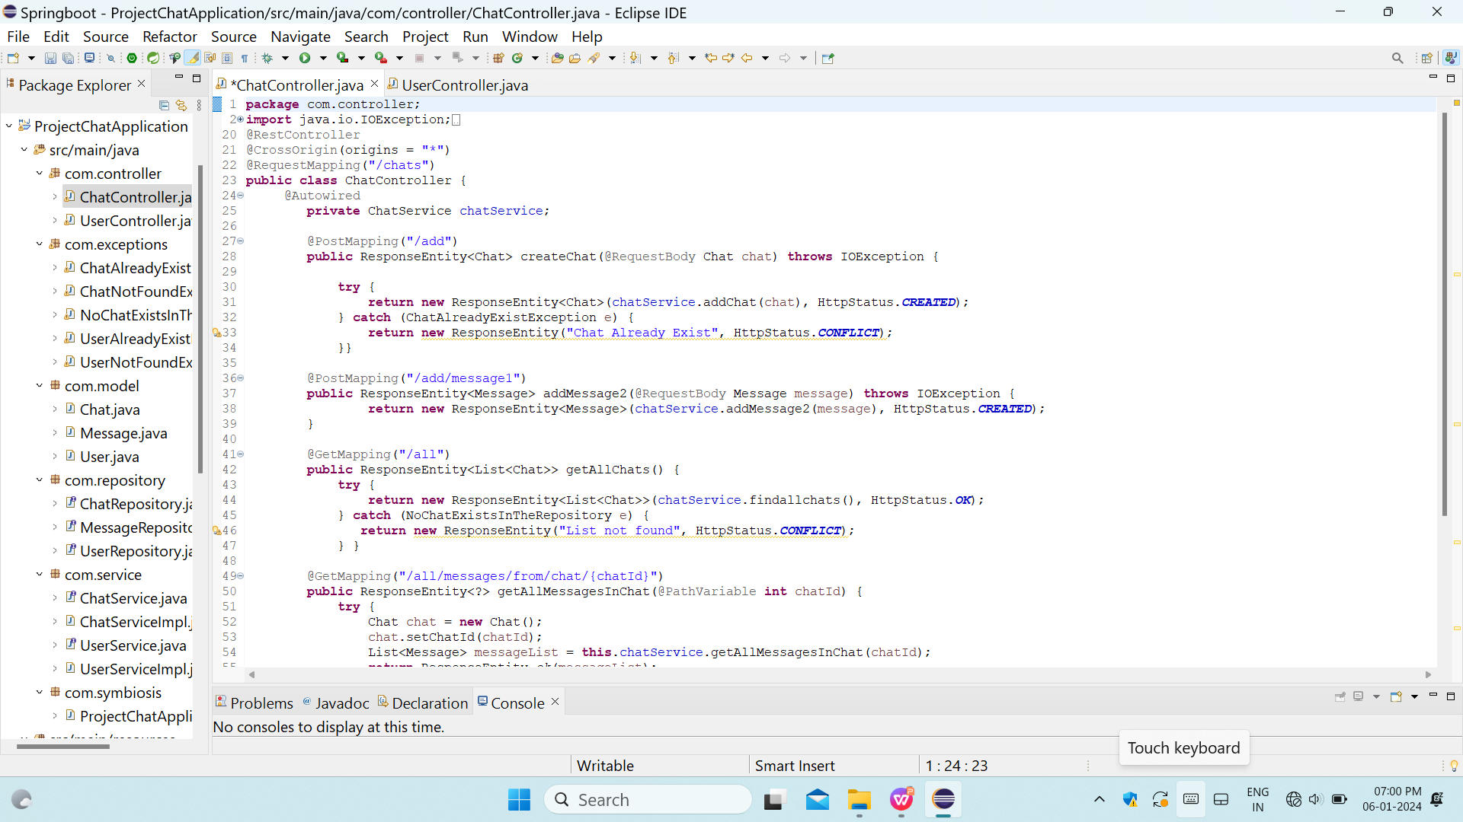
Spring boot framework
ANGULAR JS connectivity :
For connecting the back – end logic with the front – end webpage
For Adding Messages
POSTMAN (testing client) :
Postman data insertion but using the mapping annotations
View All Message
View Individual Message

Slide 11
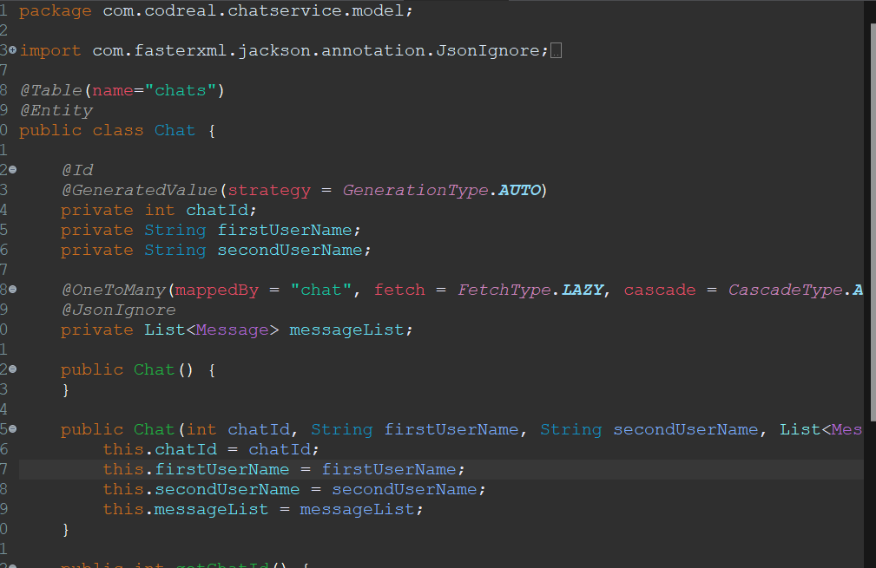
JPA – ( Mappings)
It is the mapping concept of the JPA specification due to which the Entity ( POJO ) classes are mapped with each other.
Without mapping project is not completed as there is no relation between the Entities

Slide 12
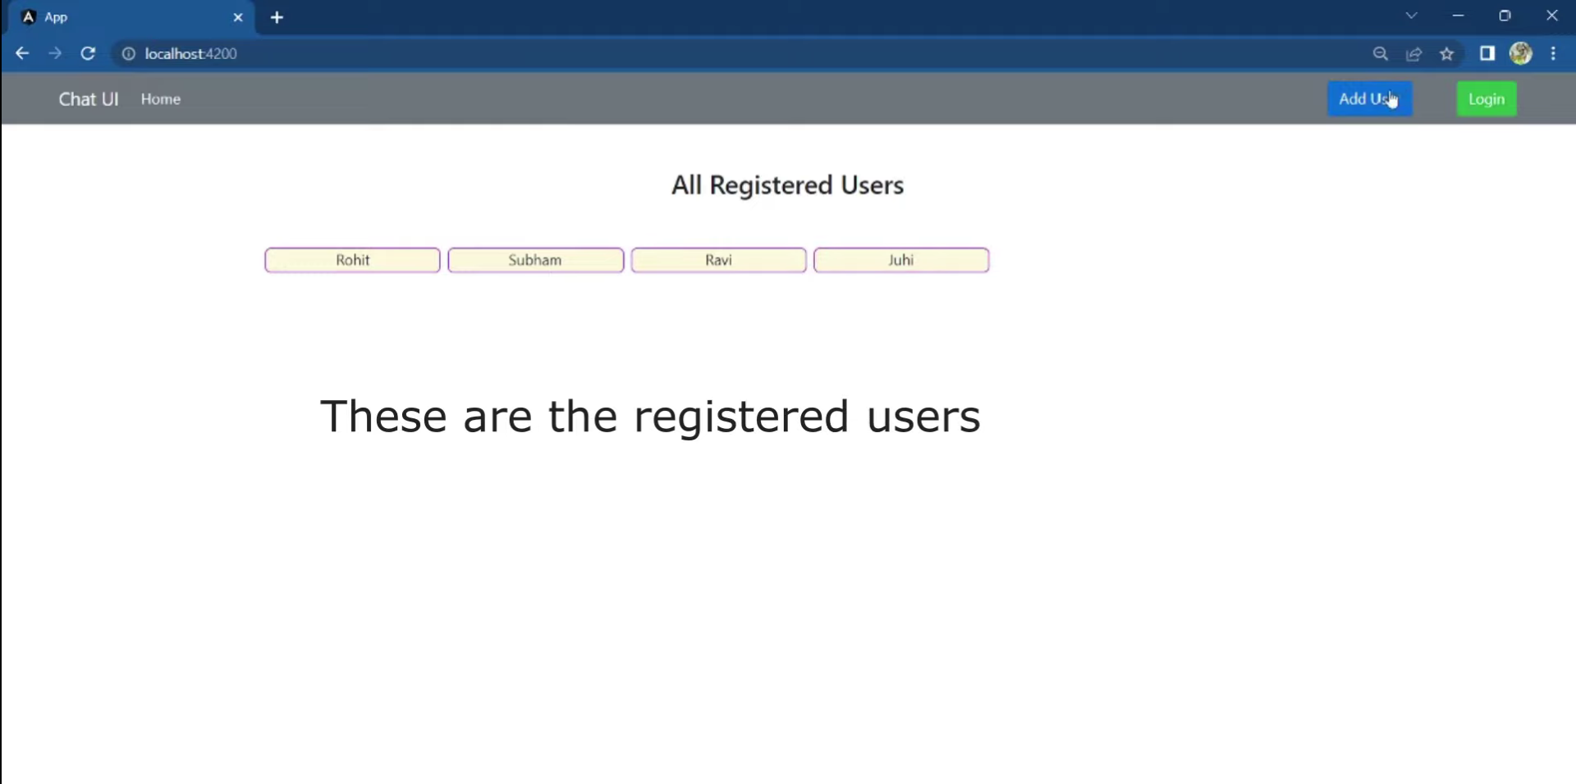
FRONT-END DEVELOPMENT

Slide 13
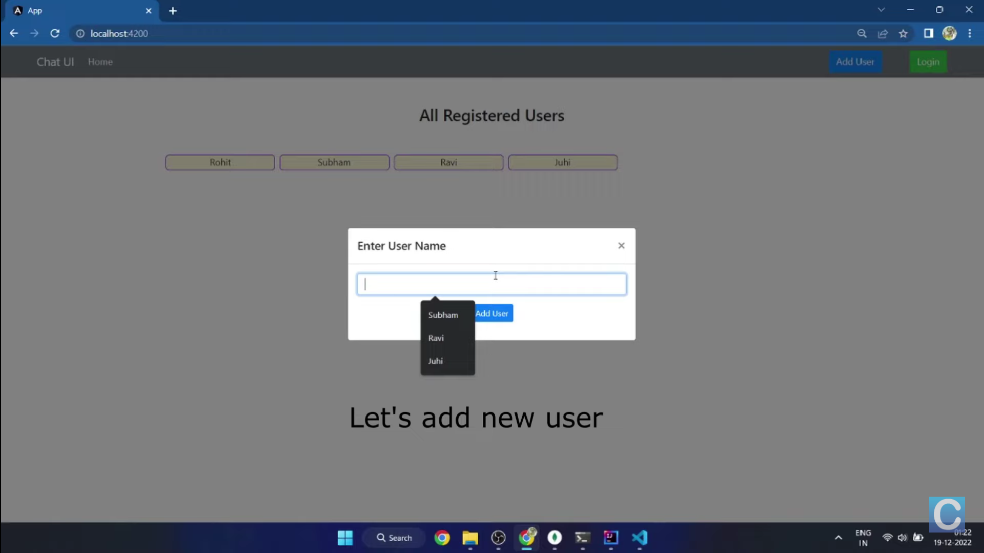

Slide 14
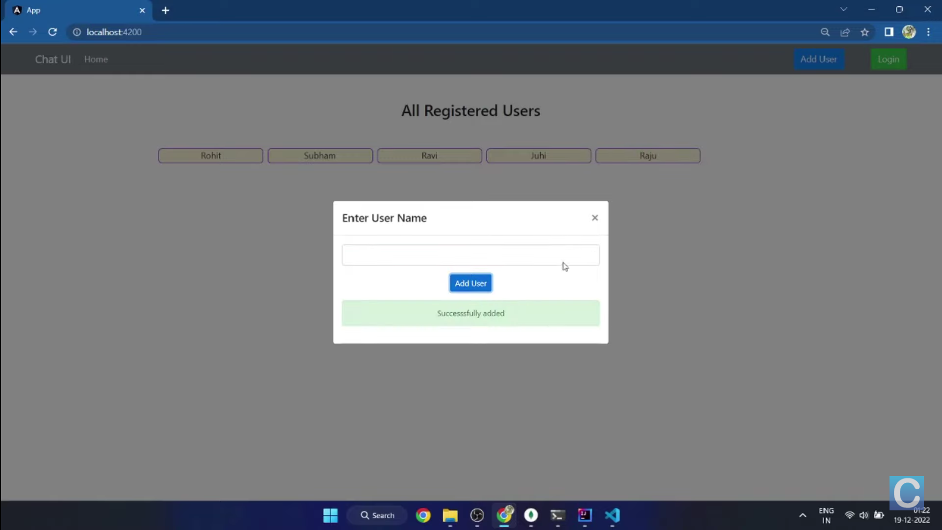

Slide 15
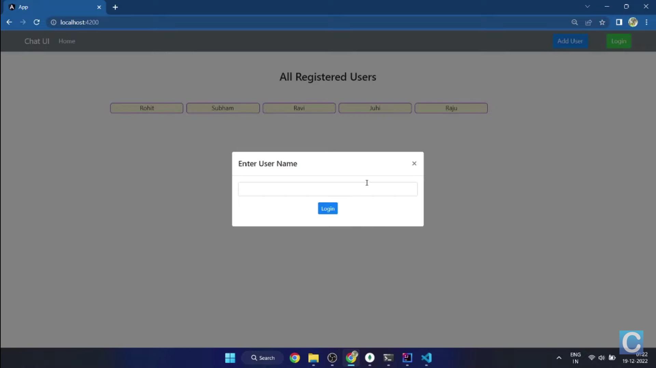

Slide 16
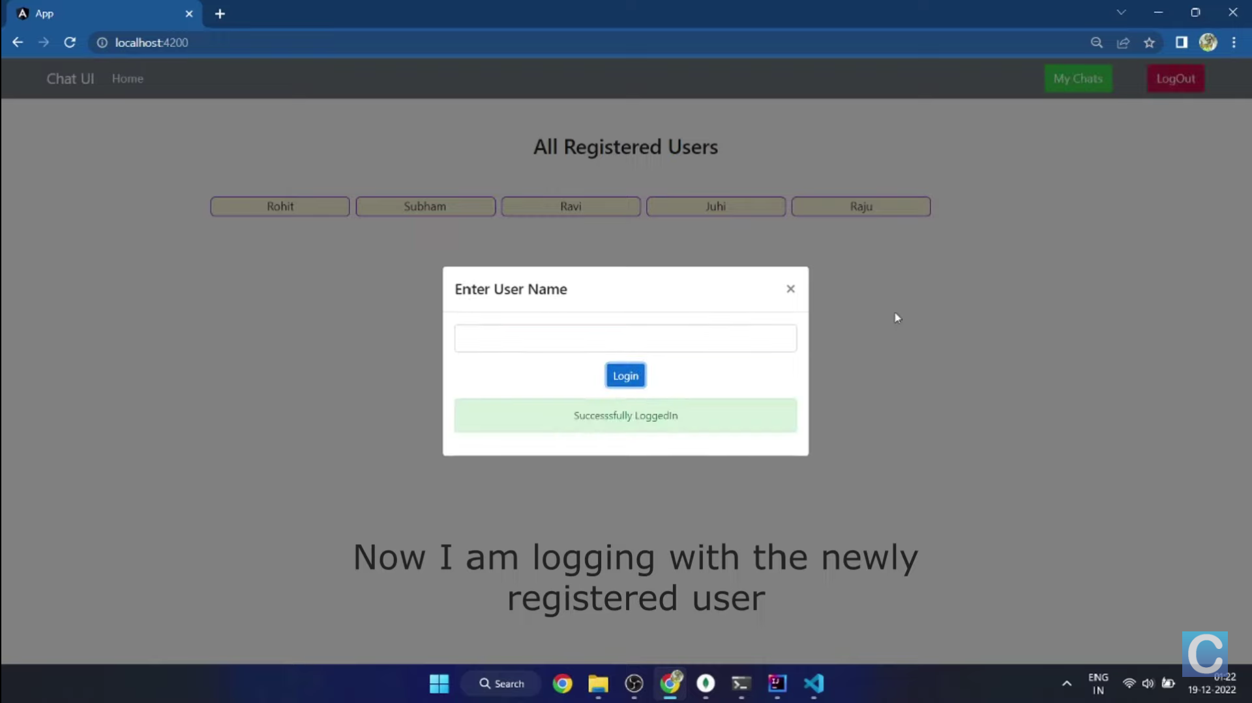

Slide 17
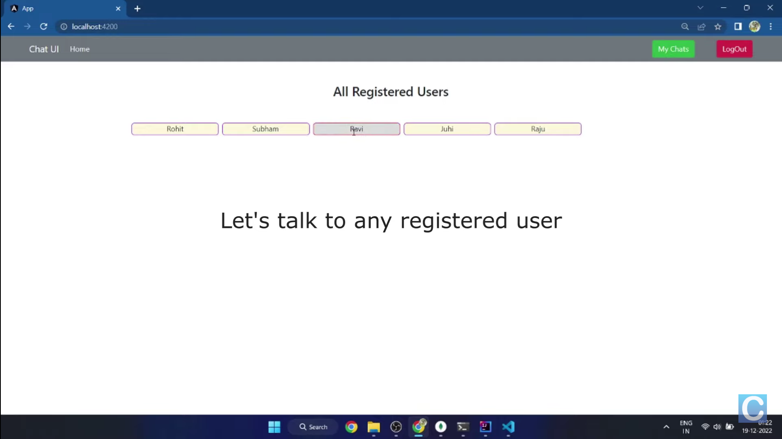

Slide 18
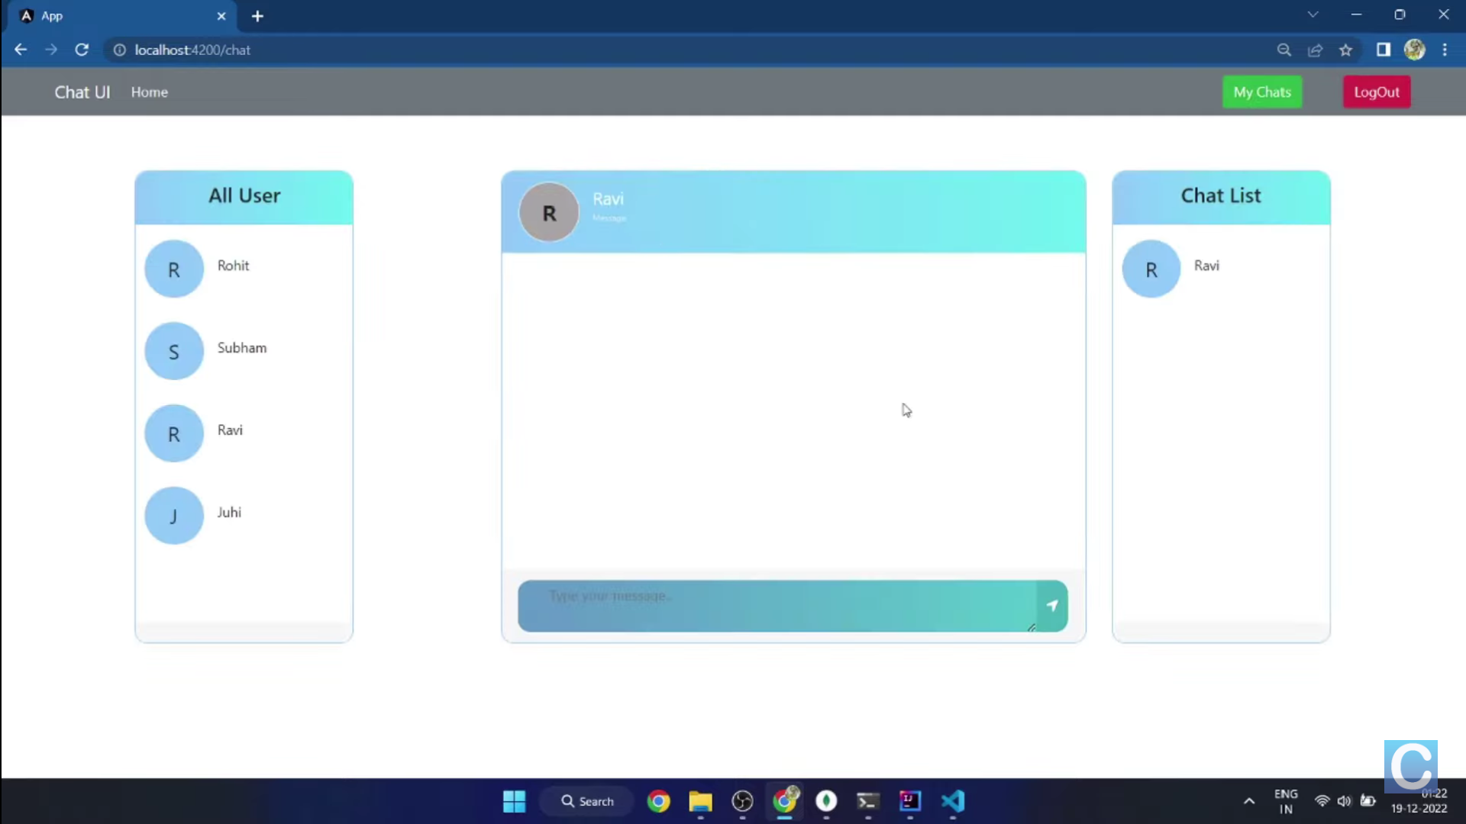

Slide 19
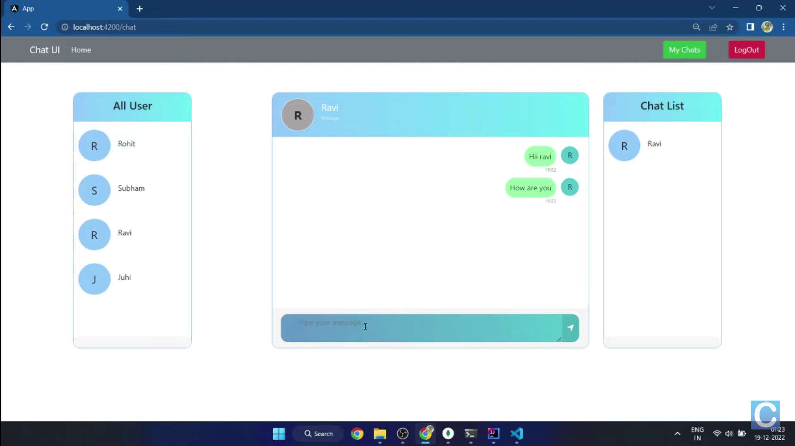

Slide 20
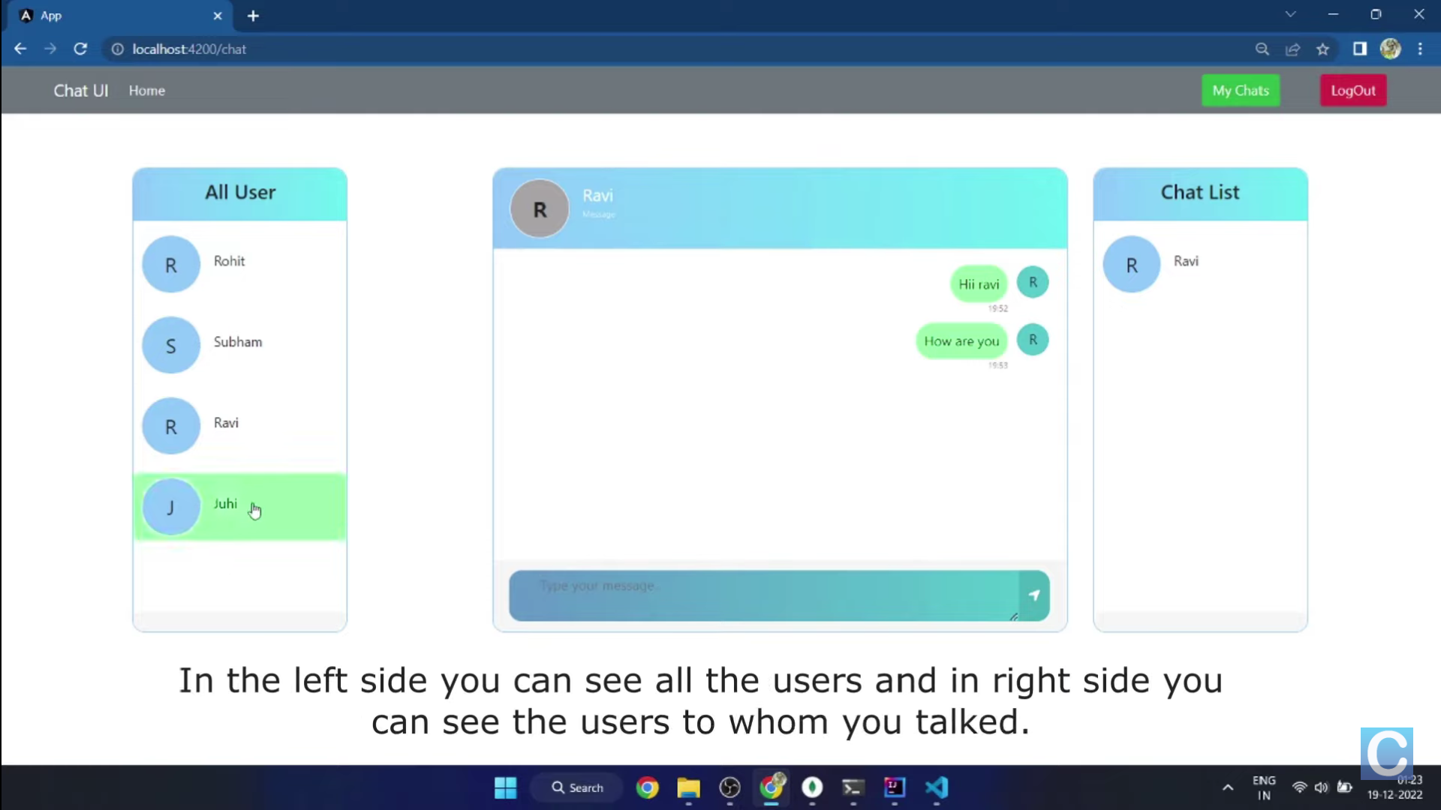

Slide 21
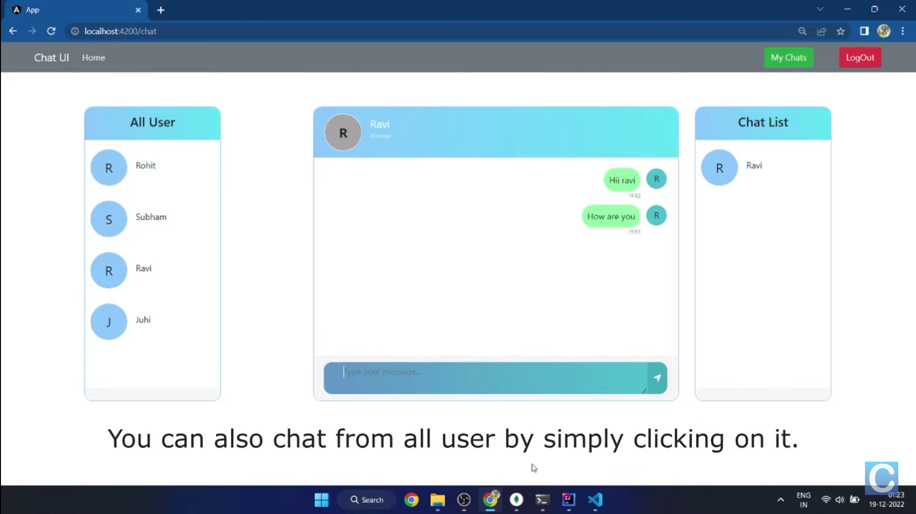

Slide 22
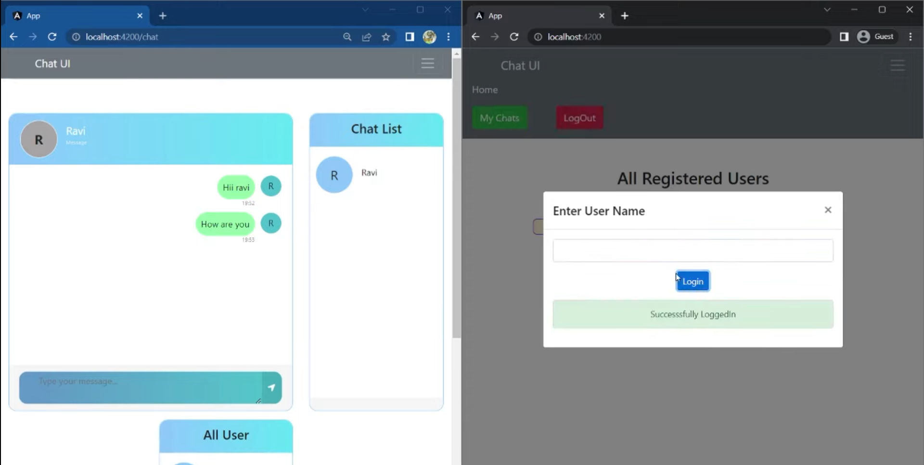

Slide 23
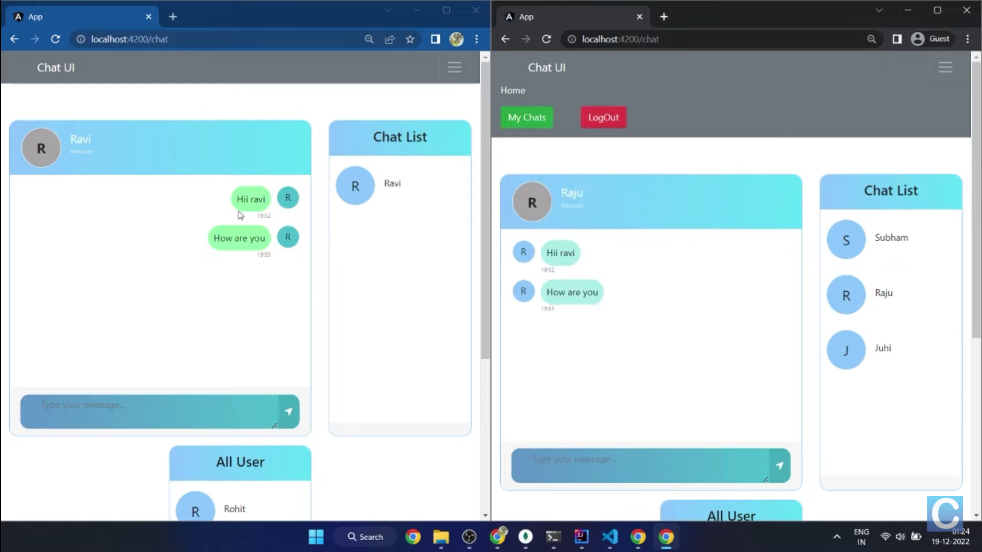

Slide 24
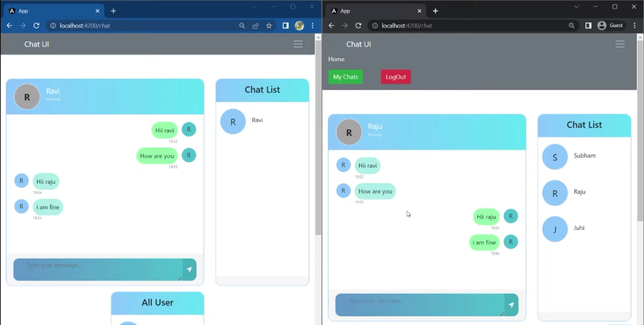

Slide 25



FUTURE SCOPE
With the knowledge we gained by developing this application, we are confident that in the future we can make the application more effectively by adding more effective services.
Extending this application by providing Authorisation service.
Providing video call service.
Sending live and current location.
Updating status.
Extending it to web support.

Slide 26

CONCLUSION
The main objective of project is development of online chat application. By Incropating future update in chat application such as technical advance ment. We are committee to develop high quality chat application by using advance sources

Slide 27
THANK YOU

